Slide 1


Qualitative Research Exploring the Ecology of Conversations during Surgical Informed Consent
Craig Lillehei, MD
Elaine C. Meyer, PhD, RN
Adena Cohen- Bearak, MEd, MPH
Institute for Professionalism and Ethical Practice
Boston Children’s Hospital
617-355-5021

Slide 2
The Issue
We tend to think of surgical informed consent
as the signing of the informed consent form
Surgical informed consent is actually the
process surrounding the form

Slide 3

A prevention strategy: aligning expectations
Our hypothesis: the closer we can align expectations of families and clinicians prior to surgery, the better outcomes we will experience. Less frustration, distress.
Surgeon’s expectations
Greater alignment of surgical team and family expectations
Parents’ expectations

Slide 4
Data collection
Method
Data
2 focus groups: 7 parent participants total
Questions
What do you remember from your initial conversation with the surgeon and nurse practitioner?
What were their communication styles like?
What do you remember about the informed consent conversation?
Who was your contact person if you had questions prior to surgery?
How well were your questions answered?
Did your expectation about what might happen fit with your experience?
Individual interviews: ongoing
Transcripts analyzed qualitatively for themes
Parent focus groups
Interviews with parents

Slide 5
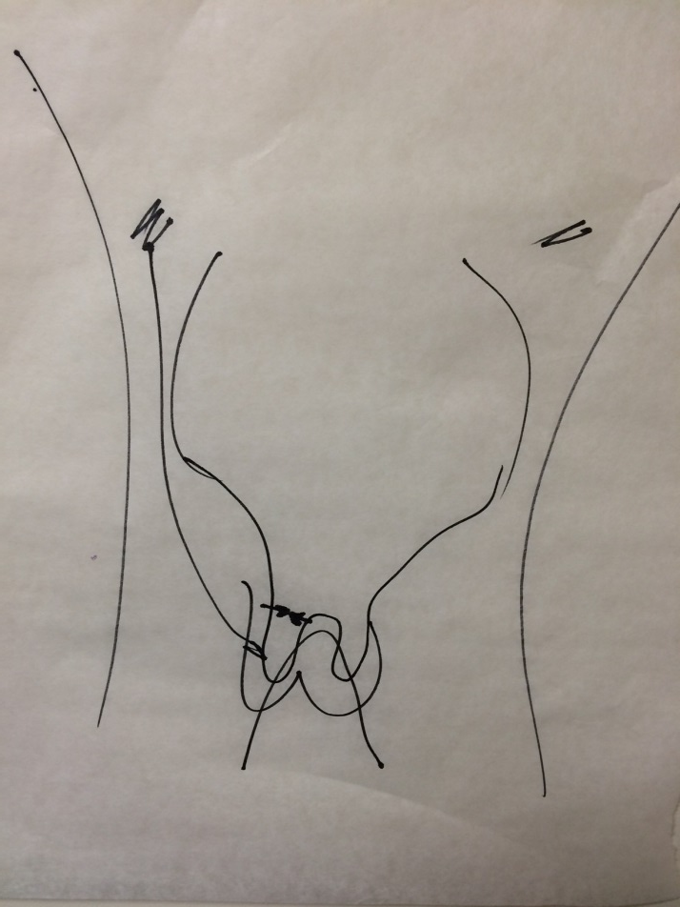
Preliminary Results
Main themes
Emotional intensity of experience for families
Families need time to process
How surgeon speaks to child/teen is important
Drawings & models are essential
Complex children take more time & preparation
Establishment of trust is crucial
Most surgical experiences are good, but families remember bad ones forever
Suggestions:
Allow enough time to ensure parents understand upcoming surgery - parents sometimes don’t know what to ask
Ask how the family is doing
More attention should be paid to aftercare instructions & support, setting realistic expectations for recovery process

